Slide 1
Mini holidays in nature

Slide 2
MINI HOLIDAYS IN NATURE
Goals:
The child discovers, recognizes and compares living beings and their environment, and ourselves as one of them.
The child discovers and learns compares the animate and inanimate nature.
Children develop a positive and responsible attitude to the environment.
Children develop a positive self-esteem and gaining independence.
Children develop coordination, accuracy, speed, strength, flexibility and endurance with long-lasting form of walking in nature.
Encourages general creativity in the preparation, organization and use of resources and space.

Slide 3
This year as well we are in the Kindergarten organized three-day holiday for children, performed by Planet children. HOLIDAY was attended by 10 teams from all over nursery. Some went to Lipica, others in Gorje and some in Srednji vrh. Primary purpose of holidays is making partnerships and socialize, and learn about nature in a different way.
Lipica - program LIPICANČEK
Children who are were in Lipica, viewed Velika and Mala dolina in Škocjanske caves, were tested as golfers, rode the pony and see the museum and Lipica Stud in Lipica. Fun was also in a hobby of LIPI- horse and drove in a carriage. They also visited the ham drying Lokev and refresh themself before going home with a real karst lunch.

Slide 4
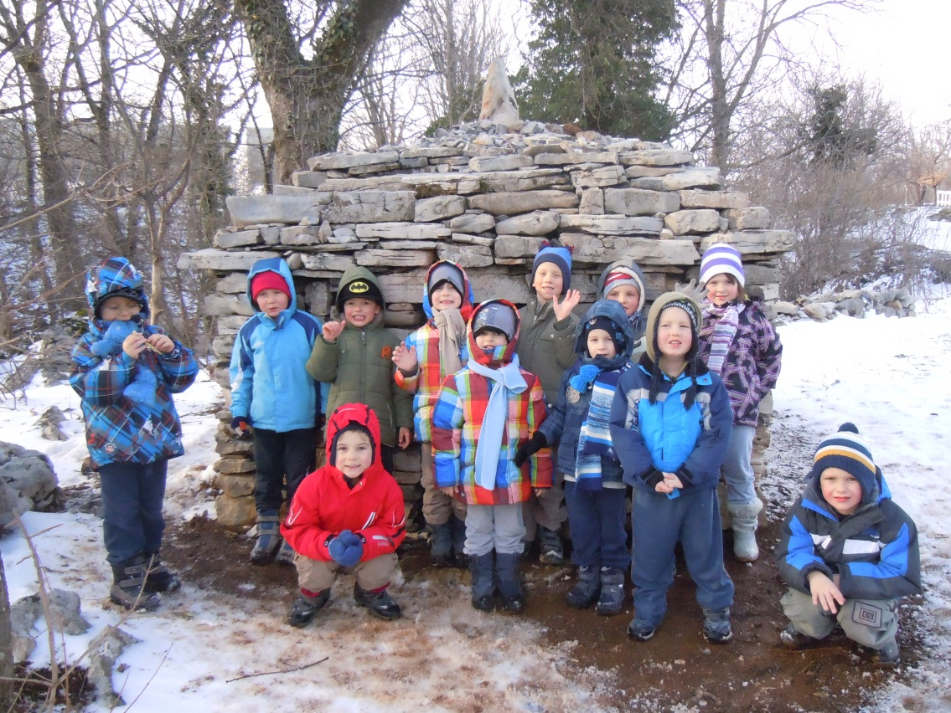
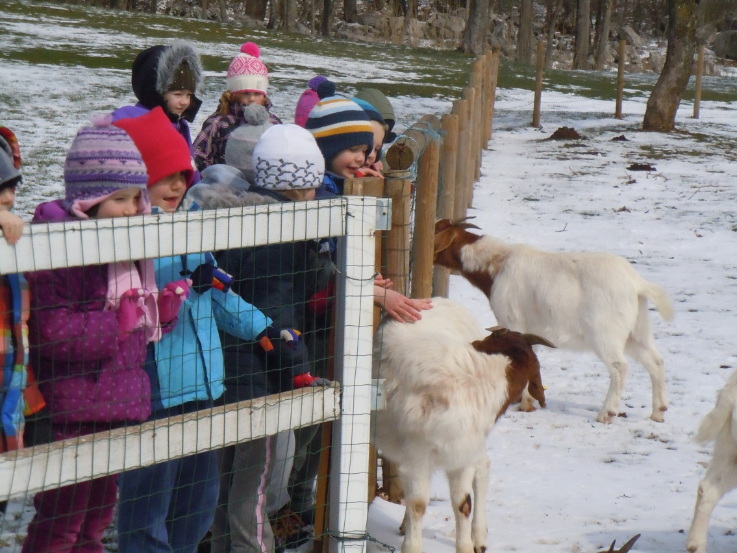
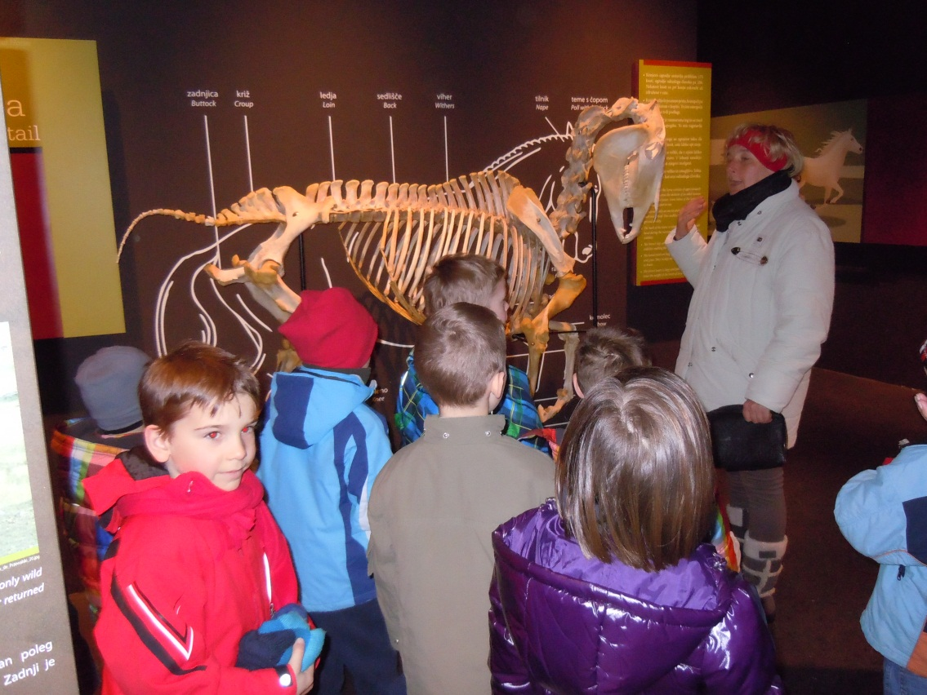

Slide 5
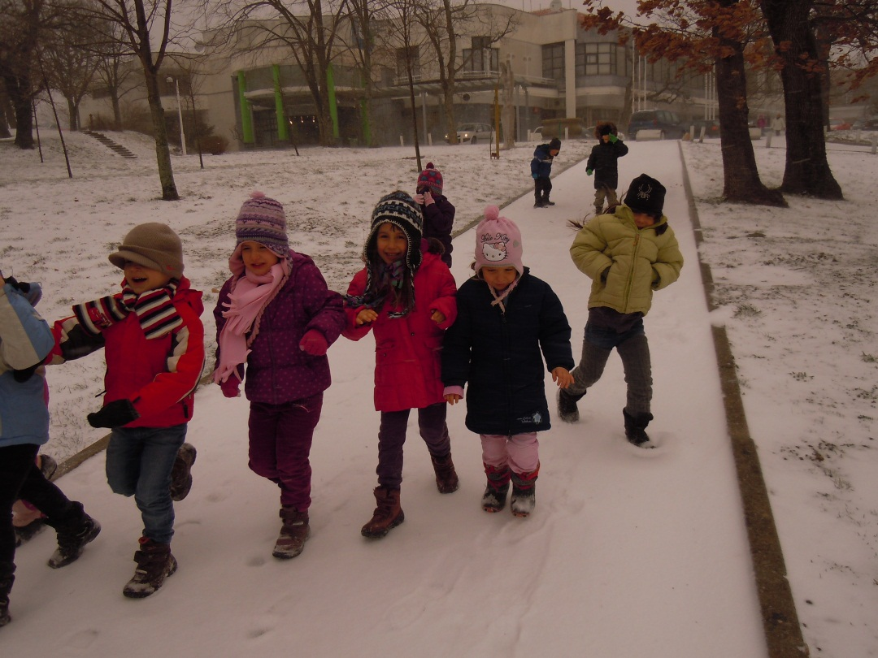
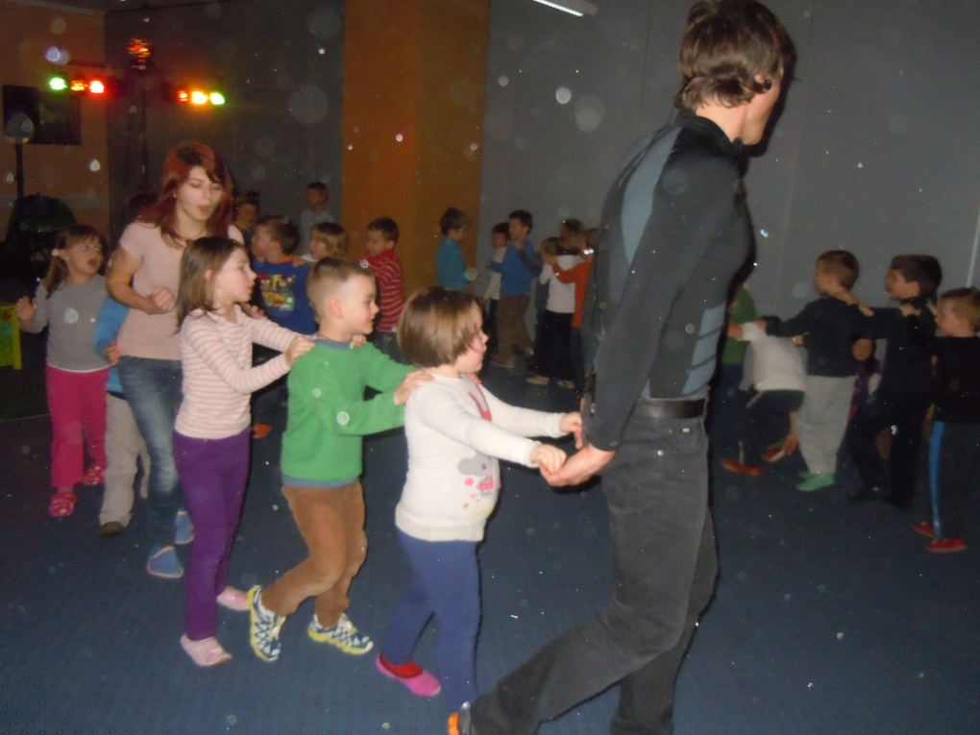
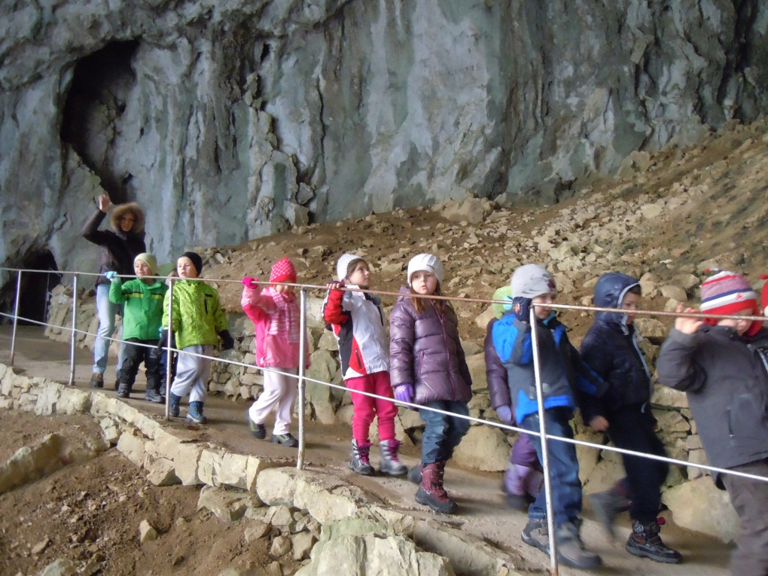

Slide 6
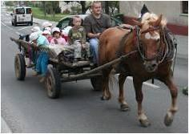
GORJE – program On the country
Children spending time in vilage Gorje, went to the farm, to help with the farm work and playing farming games. After lunch, they were taken to the old wagon-hay. The next day they spent in Bohinj, where they rode on the ranch under Studor. In shepherd's museum learned of herdsmen life. They also drove with boat on Lake Bohinj. The last day they take advantage of the rise in Višelnico,and after, they spent time till lunch in playing on playground. At the end they stopped on Lake Bled and drove with the tourist train around the lake.

Slide 7
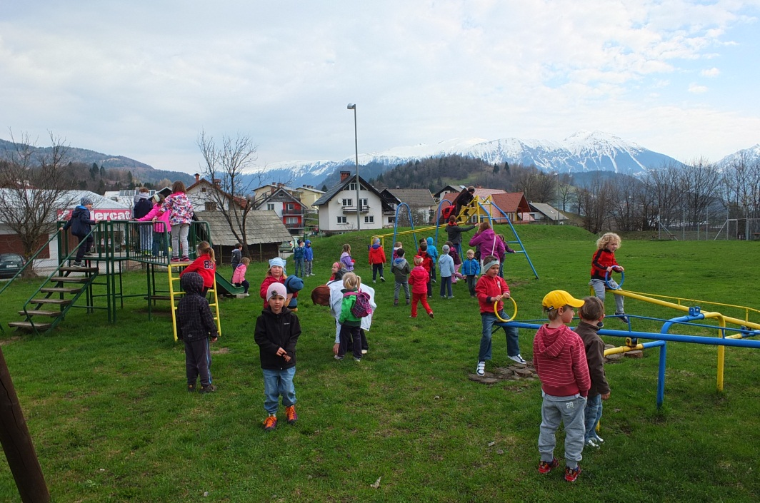
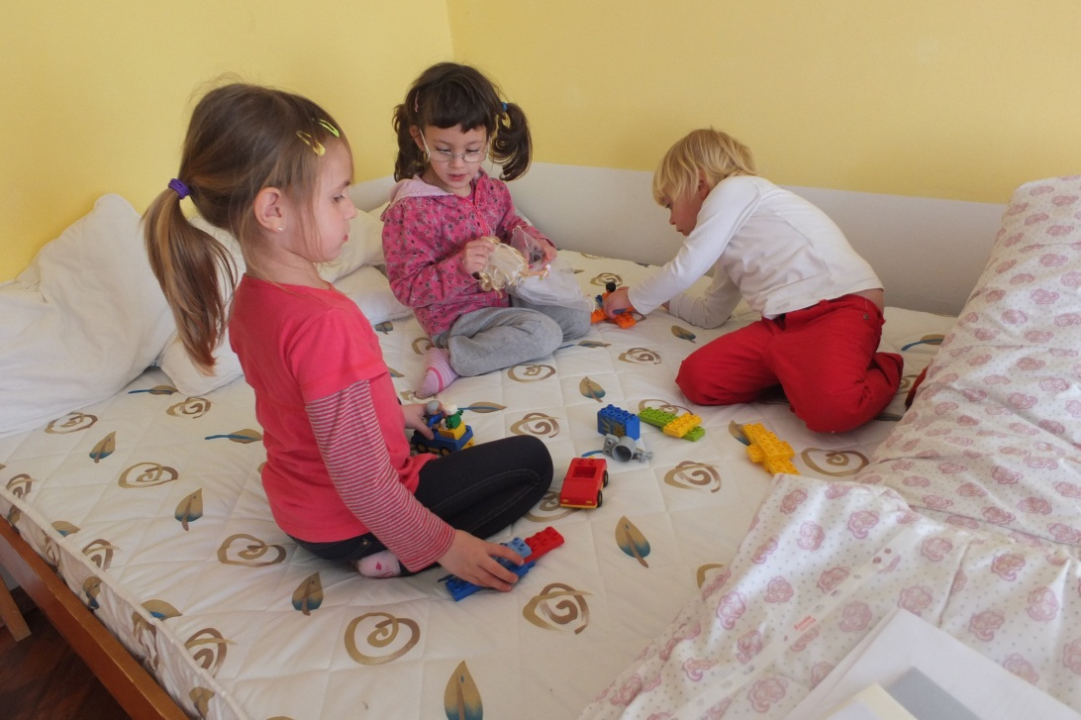
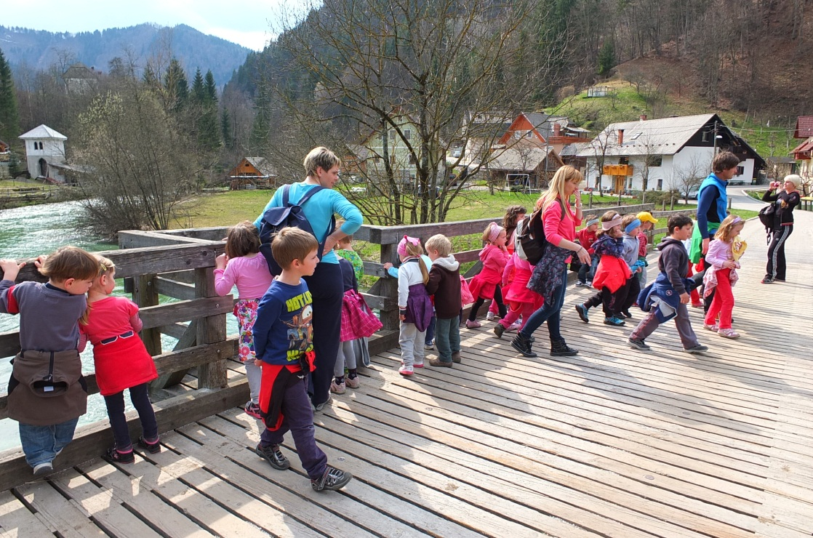
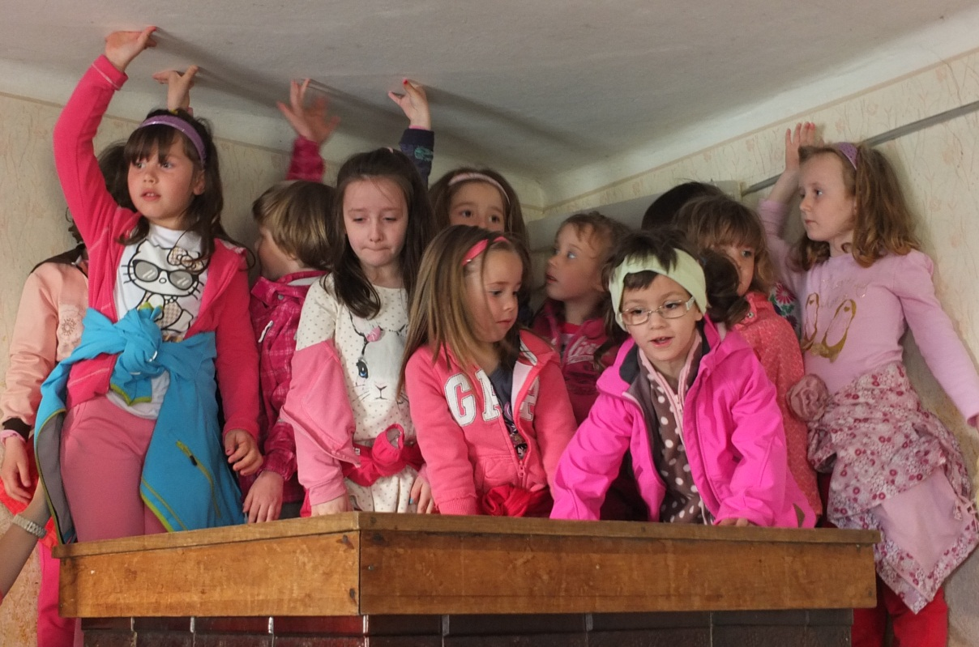

Slide 8
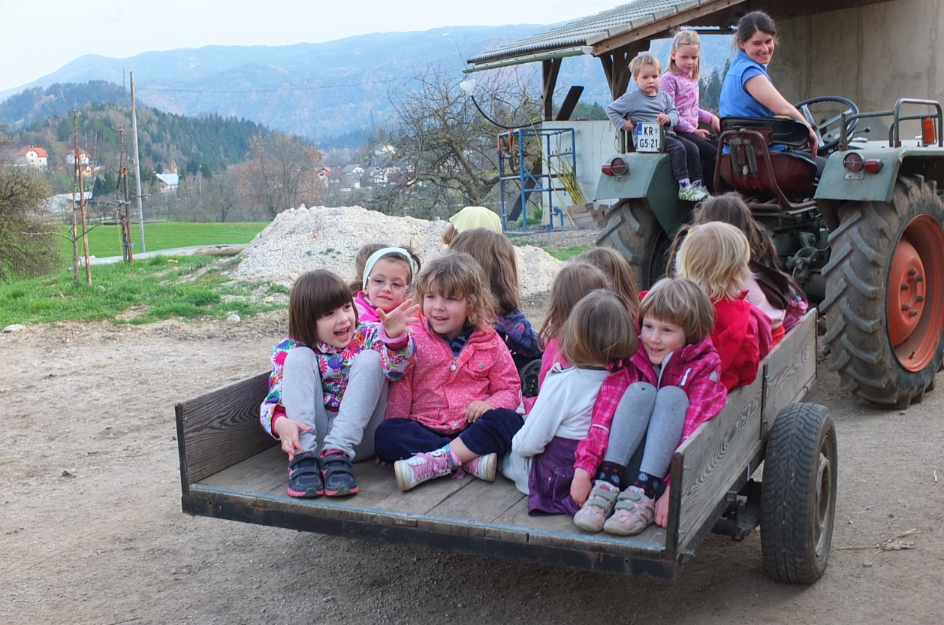
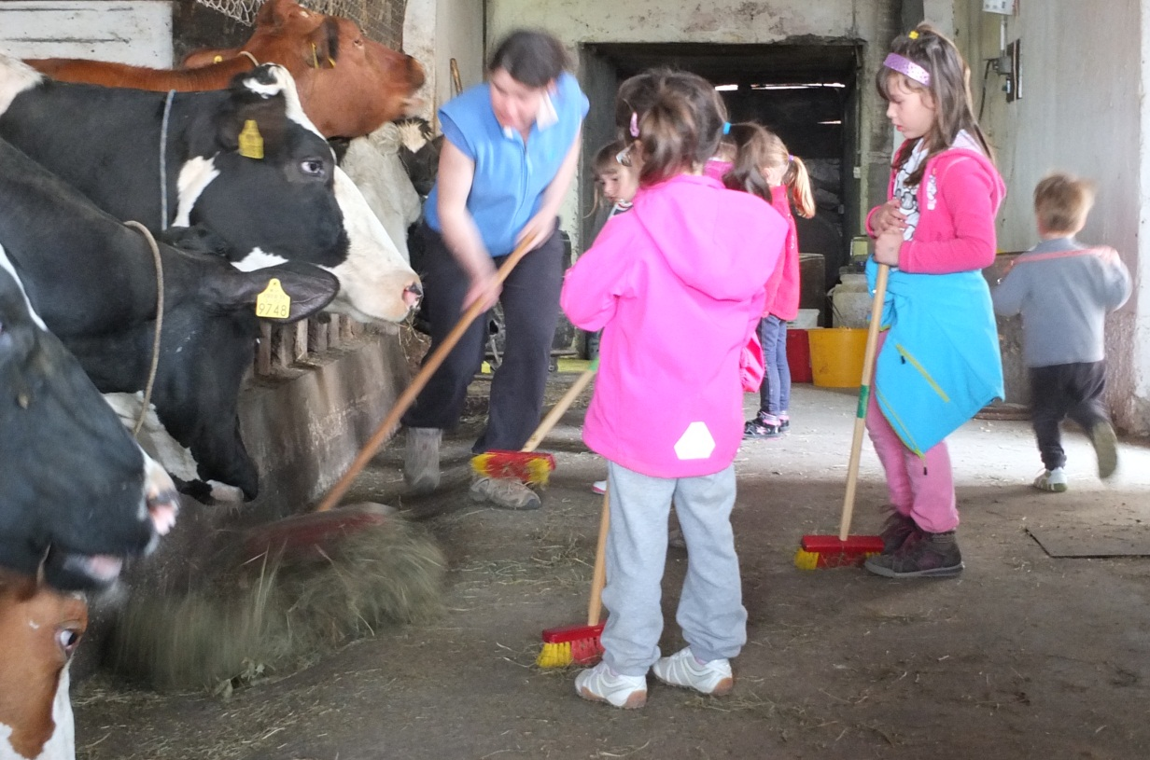
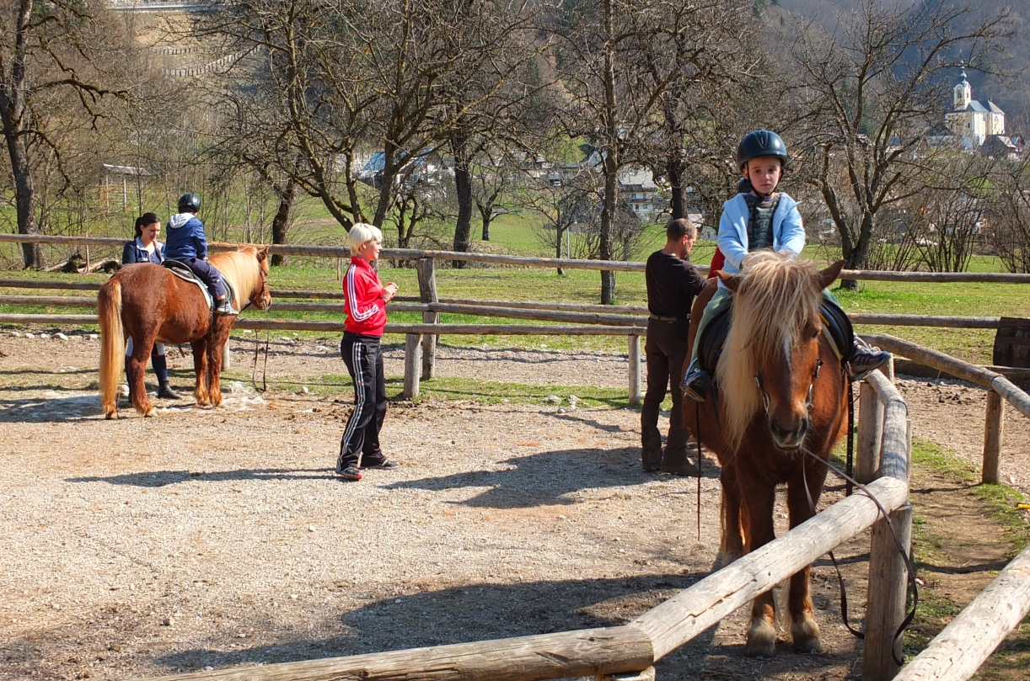
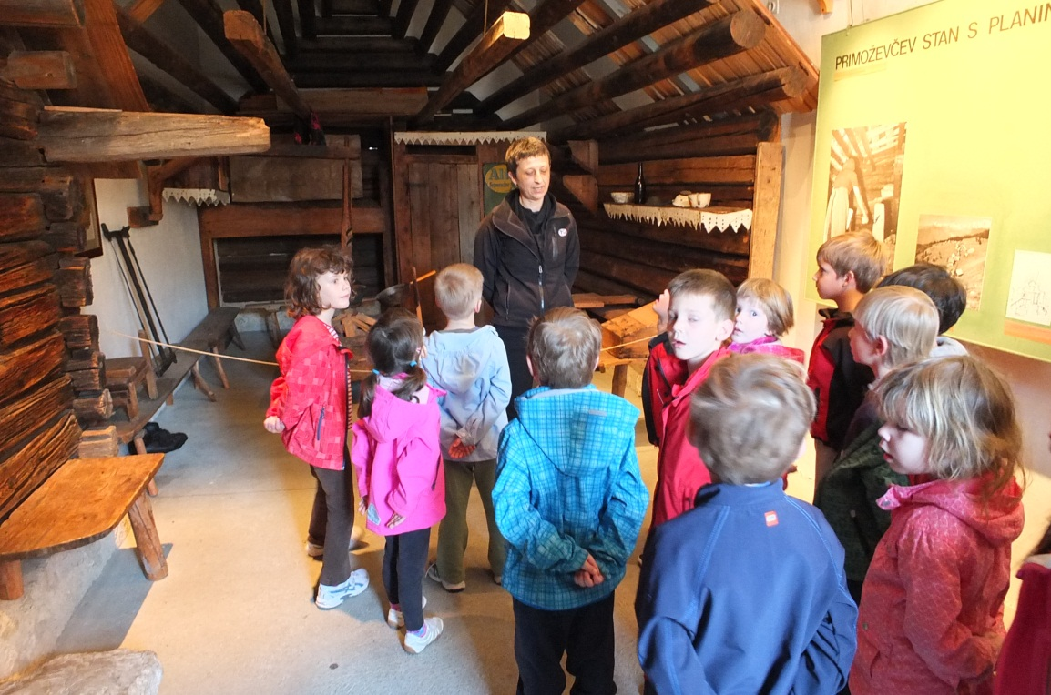

Slide 9
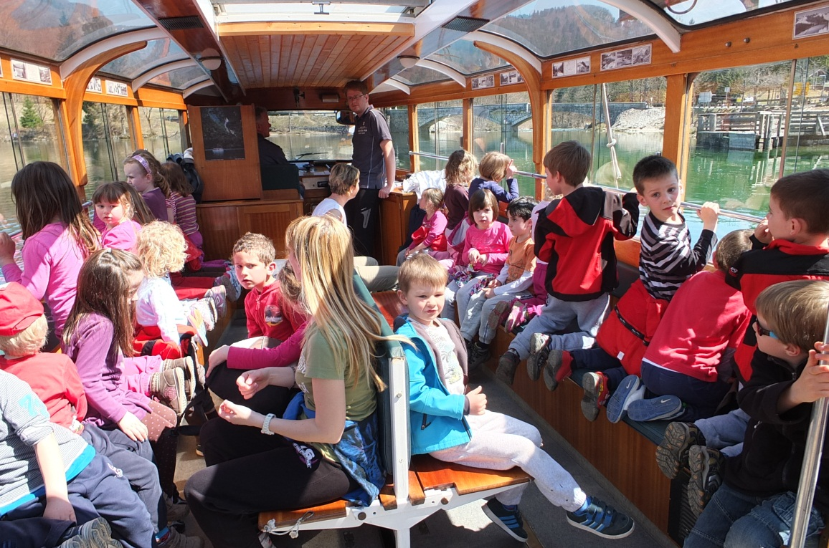
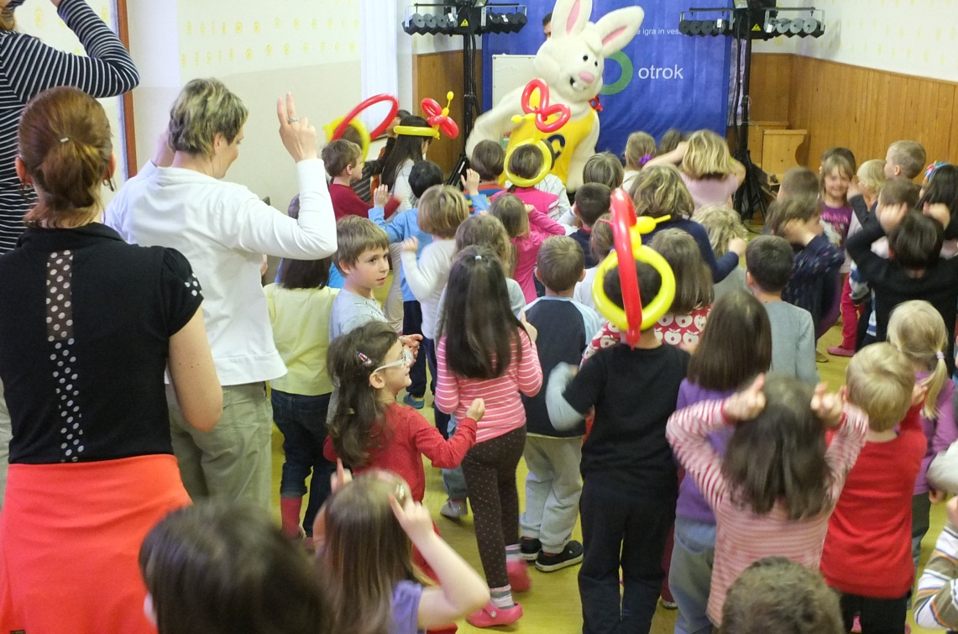
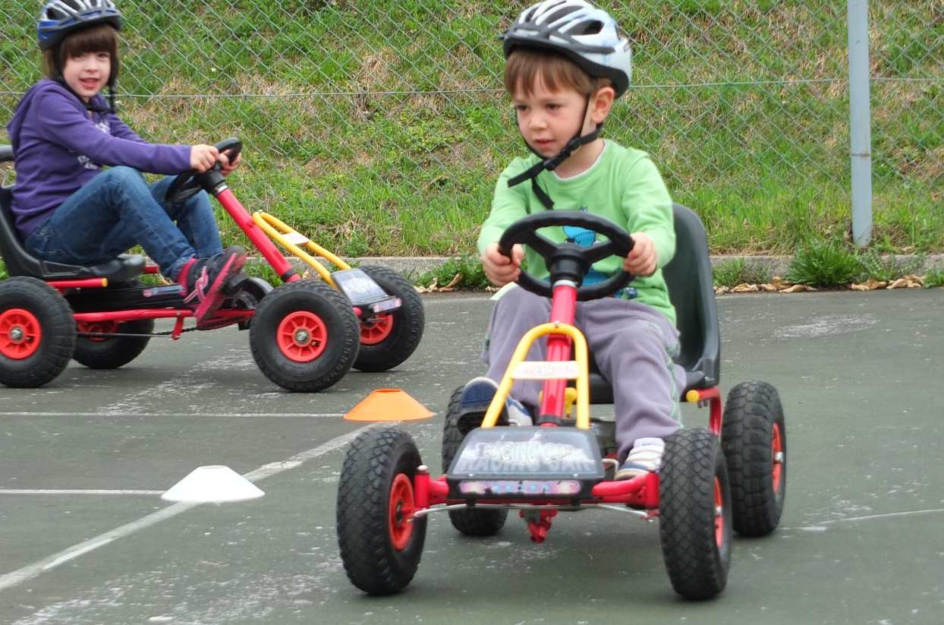
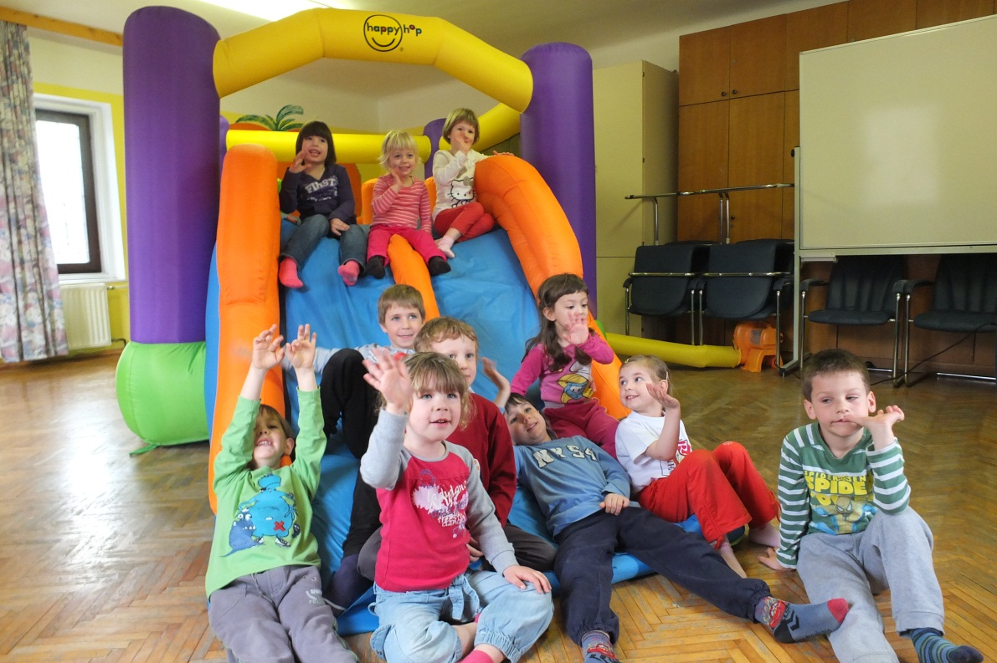

Slide 10
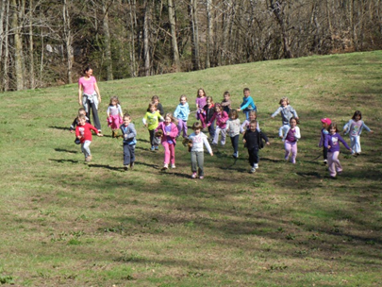
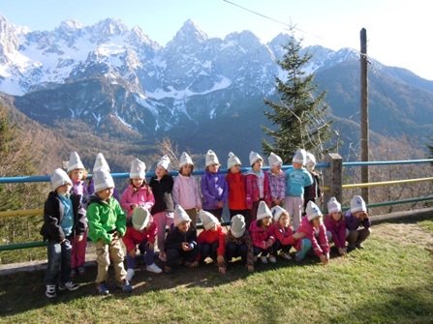
SREDNJI VRH – Shepherd program
Young travelers who visited the Srednji vrh, were transformed into shepherds. They created shepherd wore, shepherd hats and decorate them. In the cauldron boiled mush and gruel. They created shepherd's stick and shepherd's flute mills, which were tested in the nearby stream. They also view the operation of small hydro power plants. In the evening, followed by a bonfire and baking potatoes in the embers. As a real shepherds they have recognized the legality of orientation in nature and playing in shepherds humorous games.

Slide 11
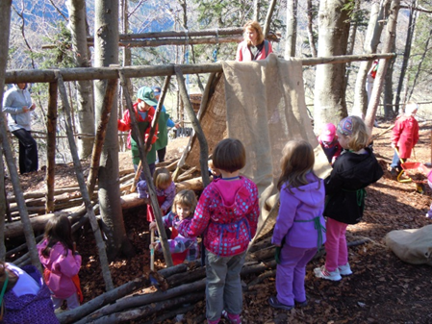

Slide 12
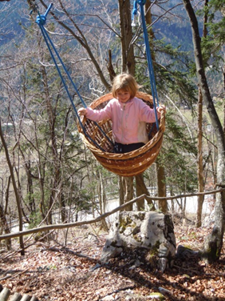

Slide 13
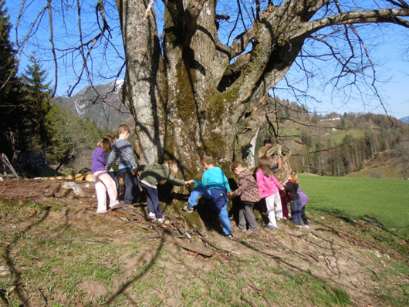
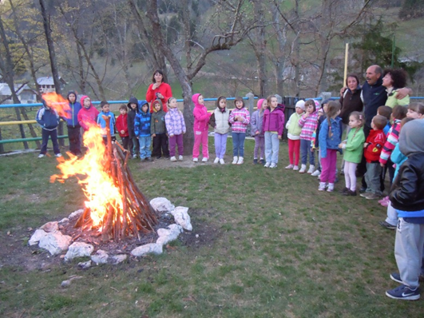

Slide 14
Good night …

