Slide 1
THERAPY DOGS ON VISIT
Vrtec Medvode
Unit Medvoška
Groups: Račke in Miške
Teachers: Ksenija Bitenc, Petra Zajc,
Magda Us and Janja Brezarič.
June 2013

Slide 2
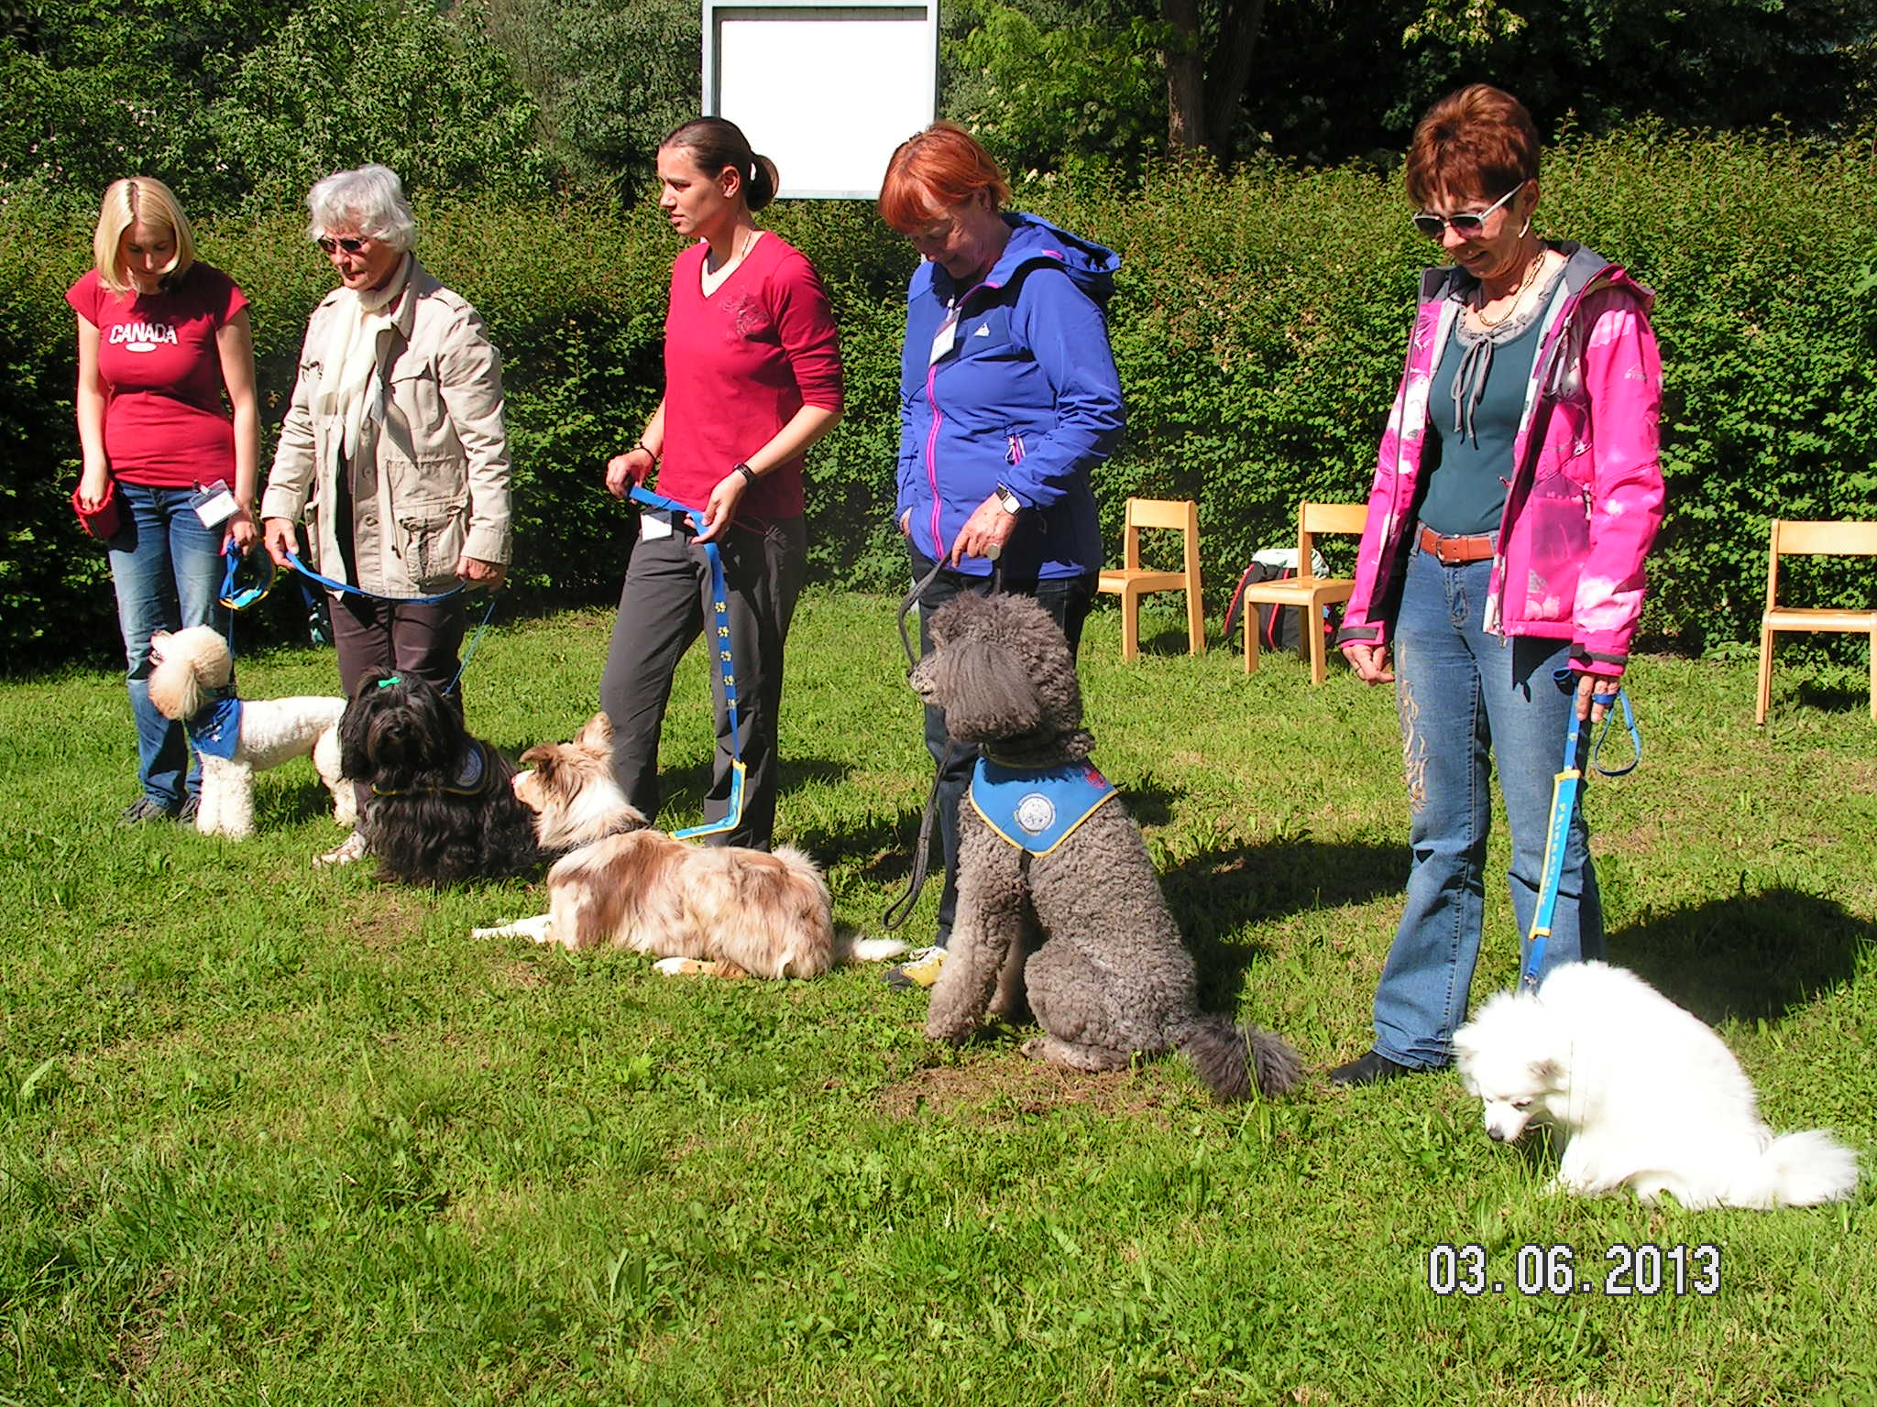
.
Slovenian Society for therapy using dogs, assist in the rehabilitation and improvement of well-being children, adolescents, adults, the elderly and persons with disabilities.

Slide 3
We were looking forward for visit very special dogs. There were five dogs, with their attendants.

Slide 4
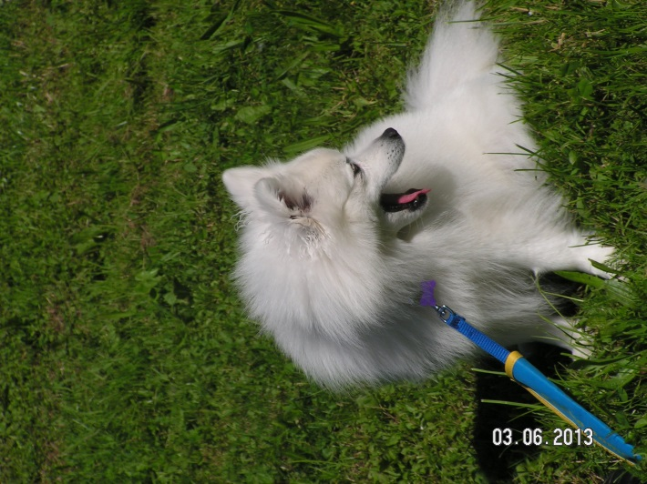
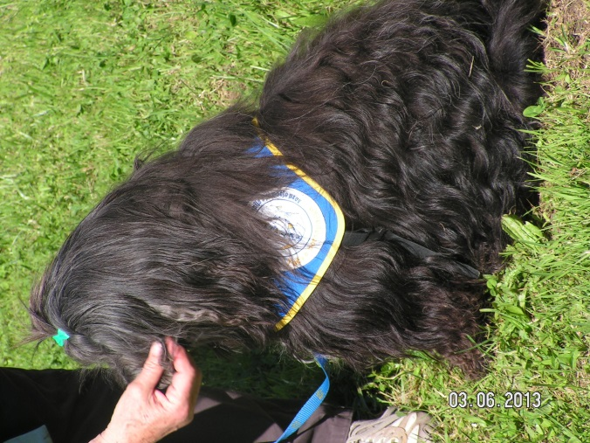
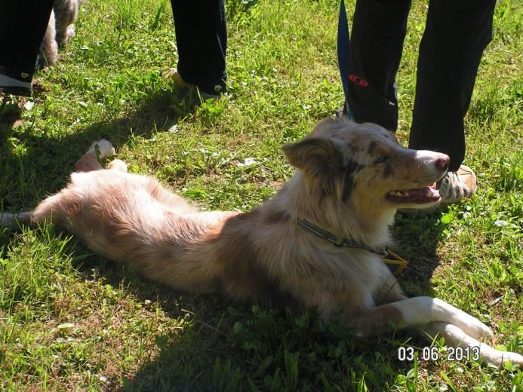
DIGA
LAM
TOBI
FJODOR
GUSTI

Slide 5
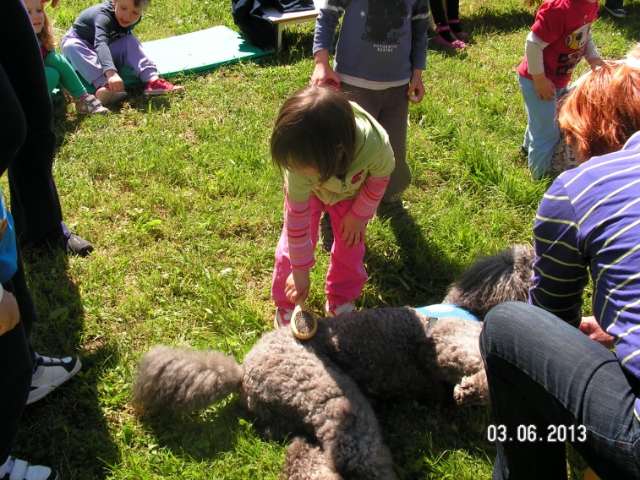
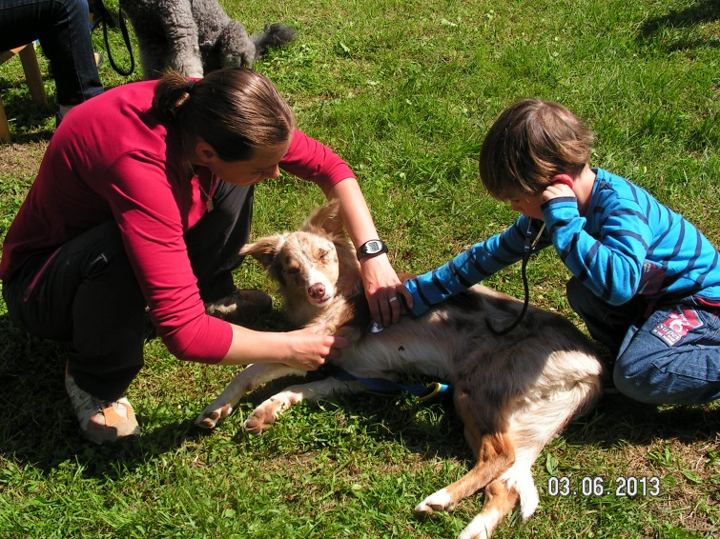
Children were constantly active: They were good assistants in combing dogs, picking up dog rubber waste, brushing their teeth and listen to their heart.

Slide 6
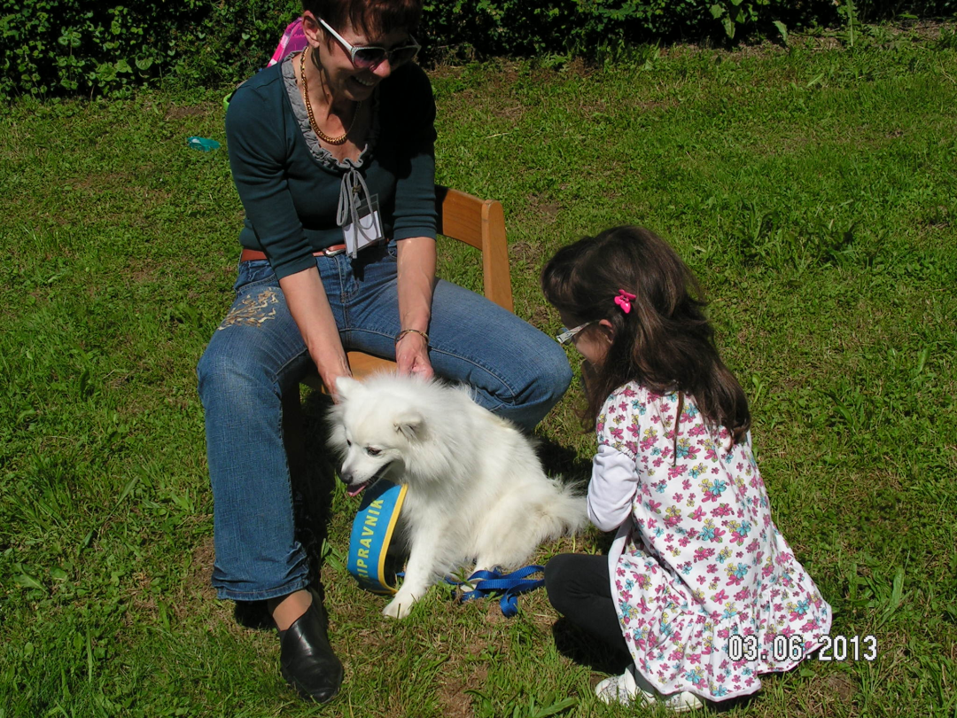
They acknowledged us how we should properly approach the dog, what dogs like and dislike or dogs fear.
We learned a lot of interesting and educative things and how our dogs can be for great help.

Slide 7
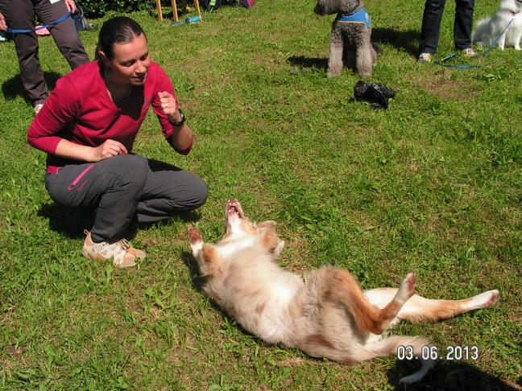
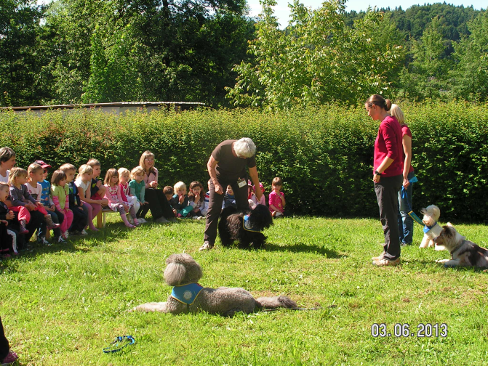
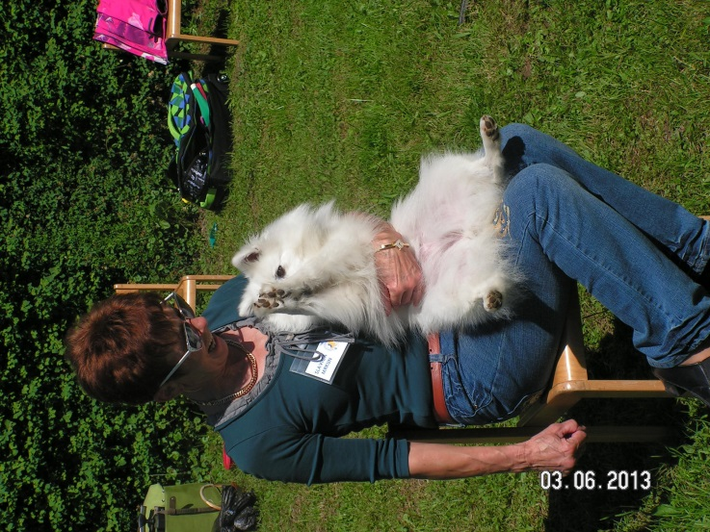
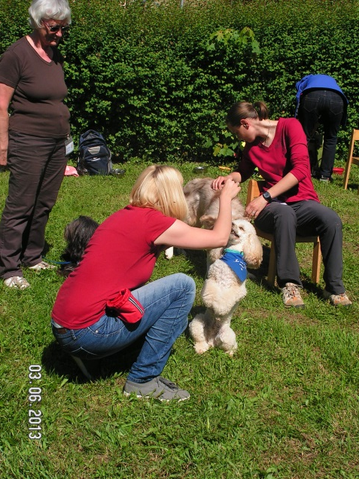
They showed us exercises such as sit, give voice, foot, high five, space, makes eight, roll it, hide it ....

Slide 8
Since the dogs were very successful, they getting a dog‘s biscuit at the end. .

Slide 9
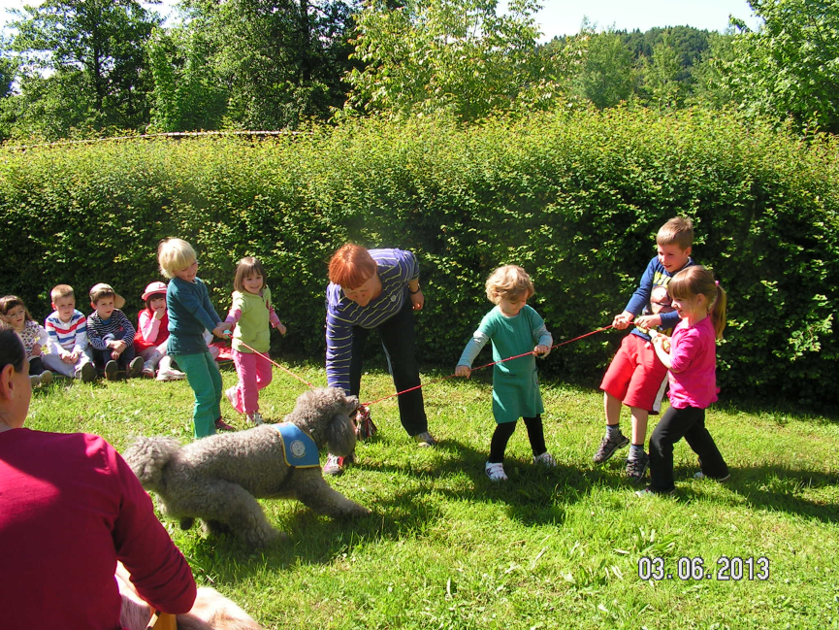
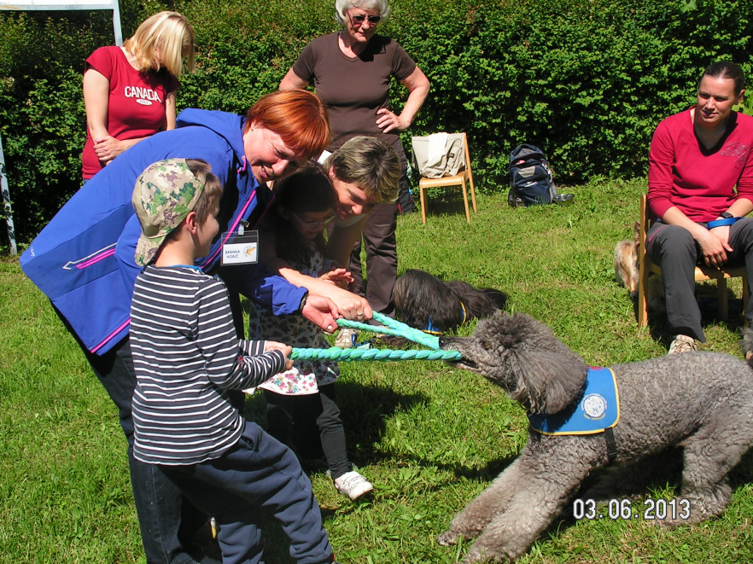
Children competed in a tug of war.

Slide 10
Time with therapy dogs quickly passed too quickly…

