Slide 1
MAKING AN ANIMATION „Medvodko in trouble“

Slide 2
This is Medvodko; a friendly creature who lives in lakes and rivers.

Slide 3
We created a character based on our content – a person who is bullied.
Our puppet had to change emotions:
being happy,
sad,
crying
or being surprised
We used green hairy metal wire to controle his body.

Slide 4
We were creating the animation once a week with a group of children of six.

Slide 5
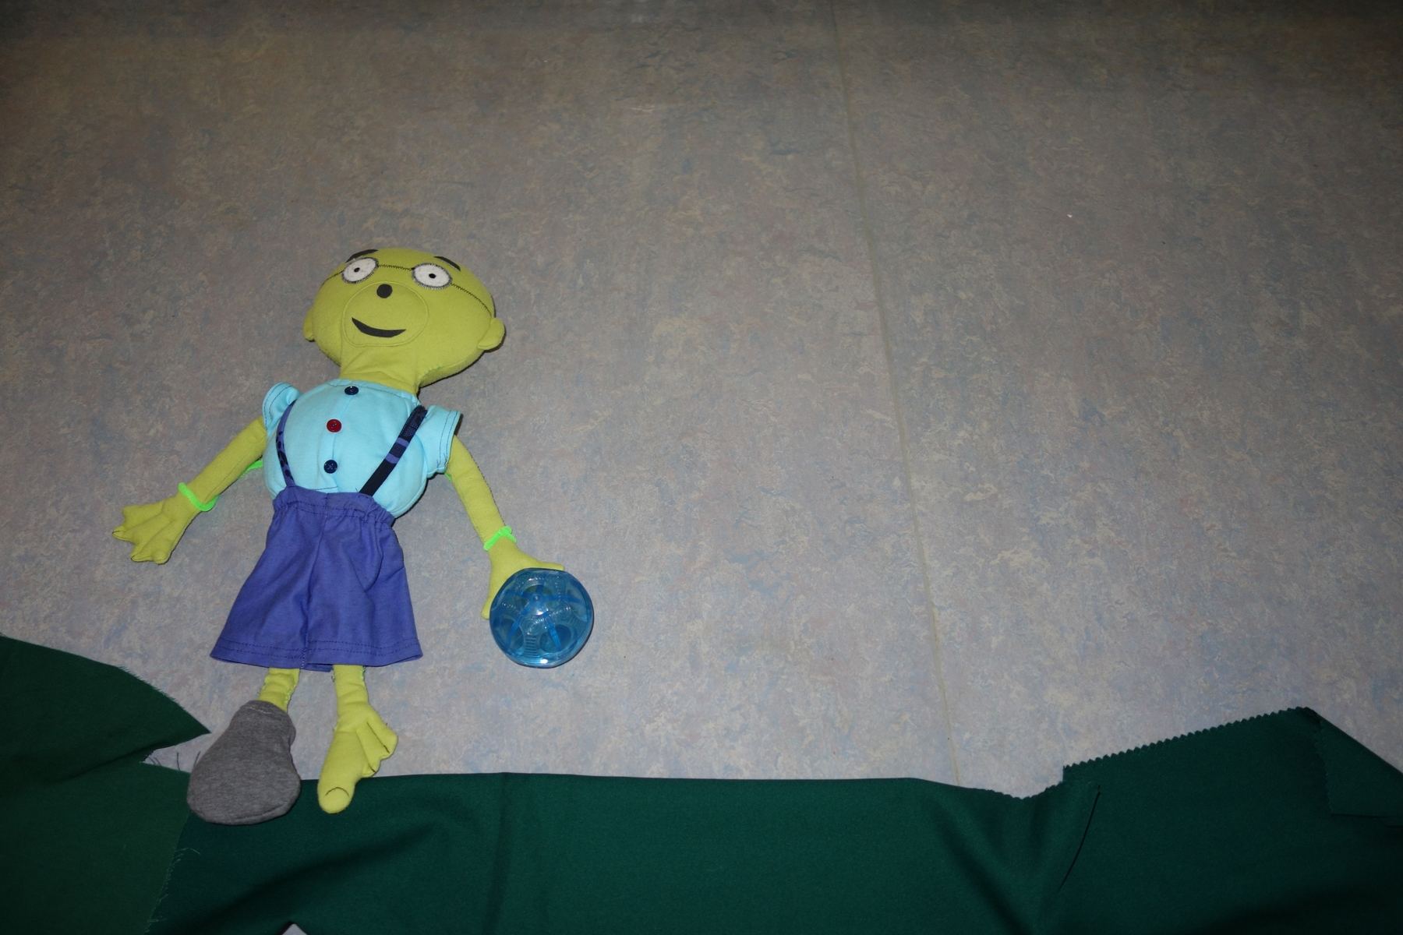
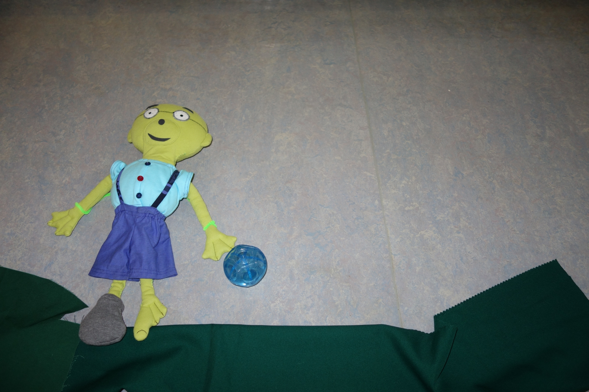
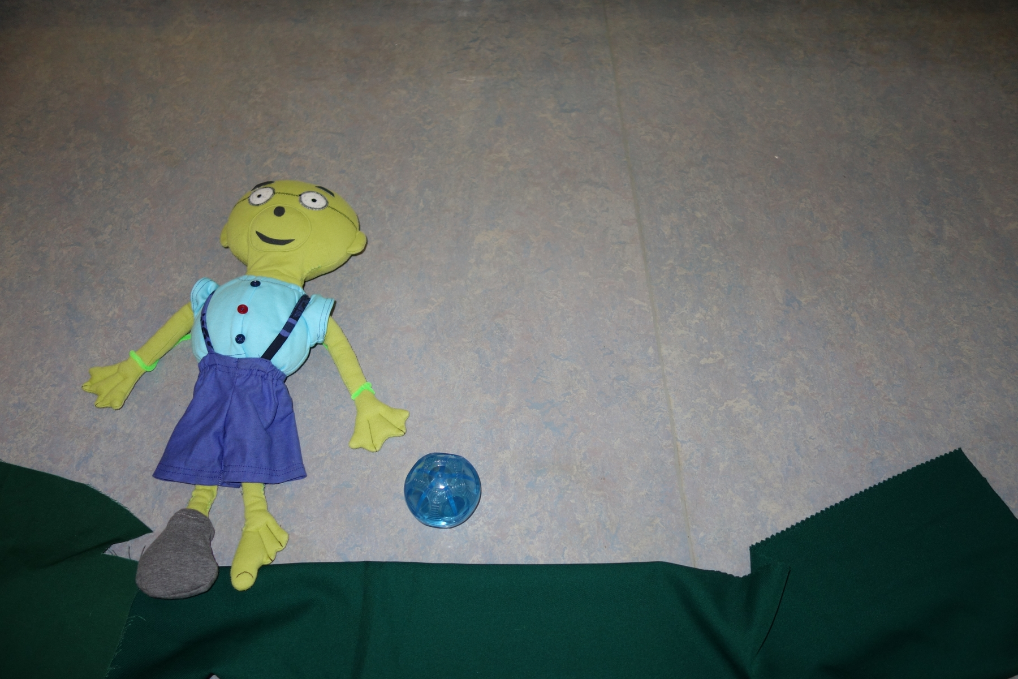
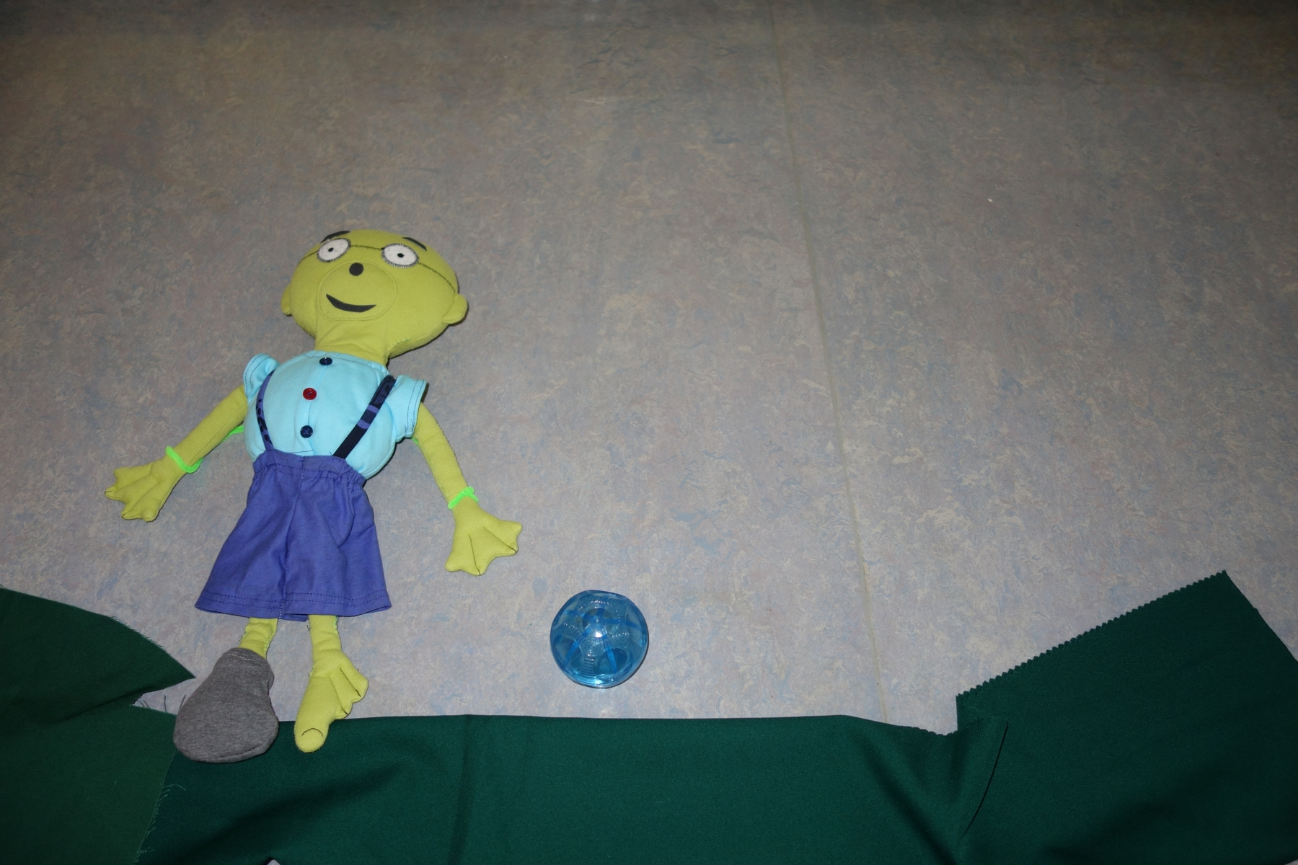
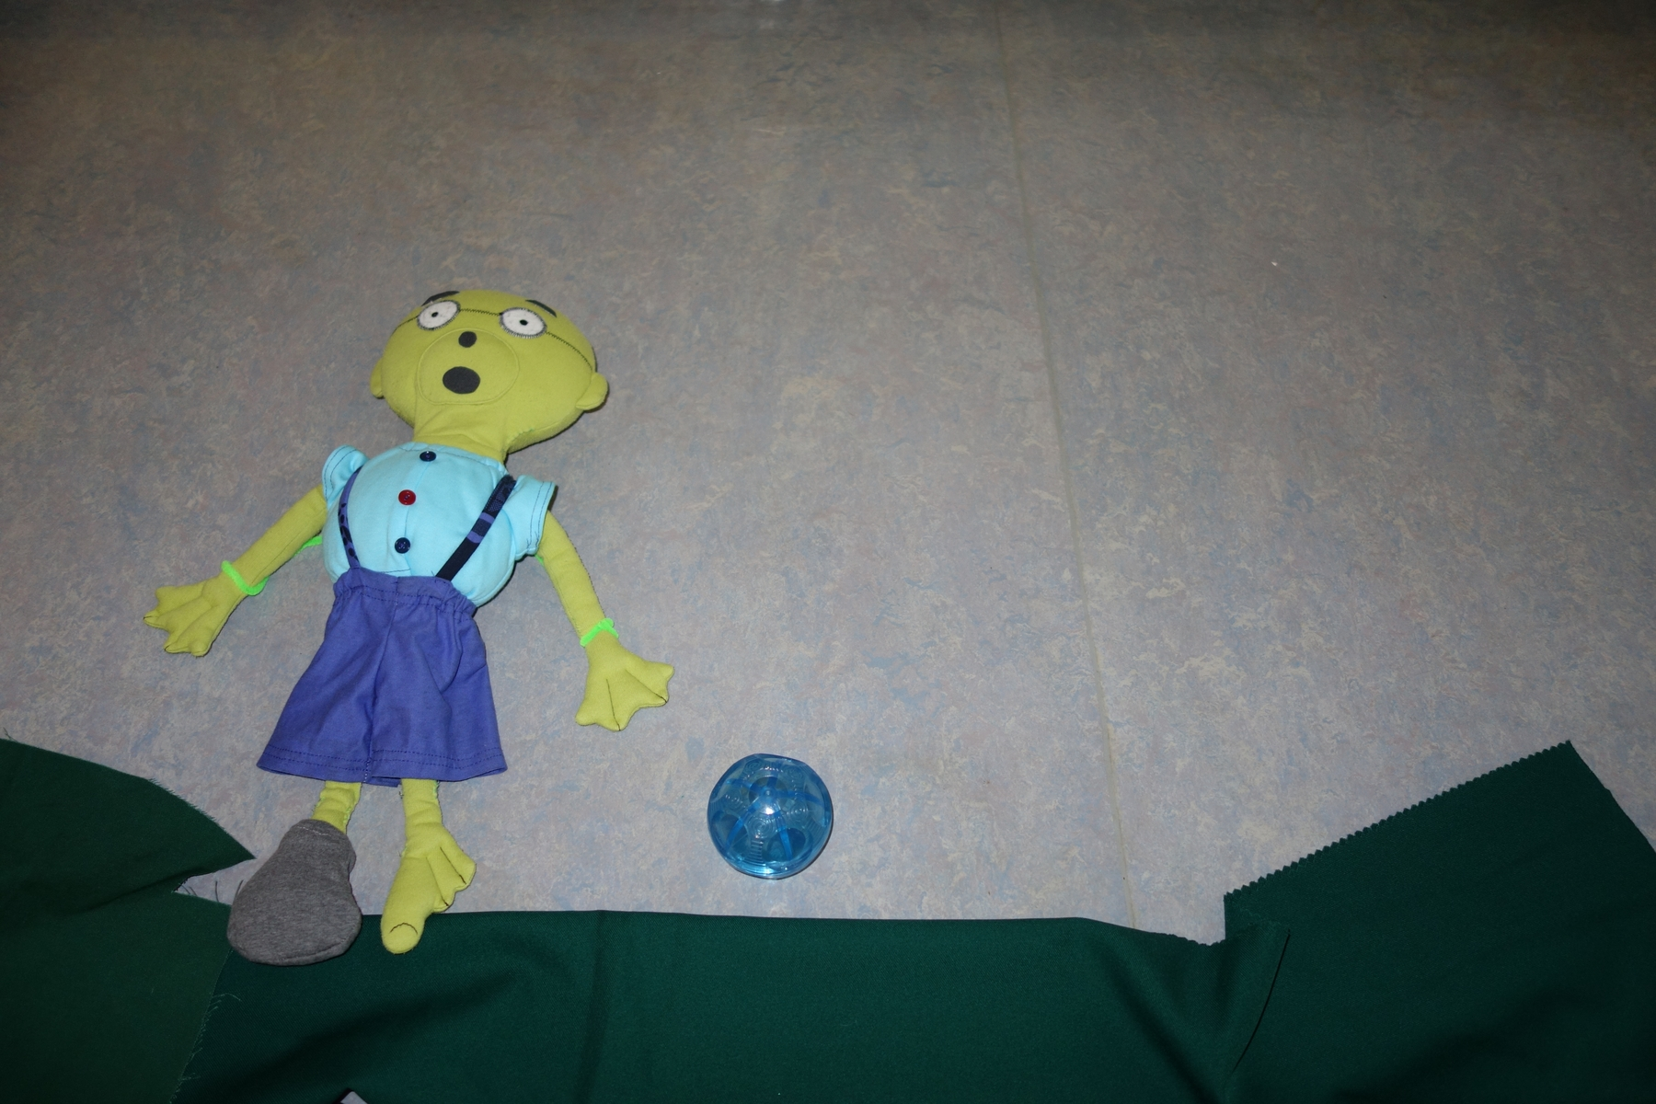
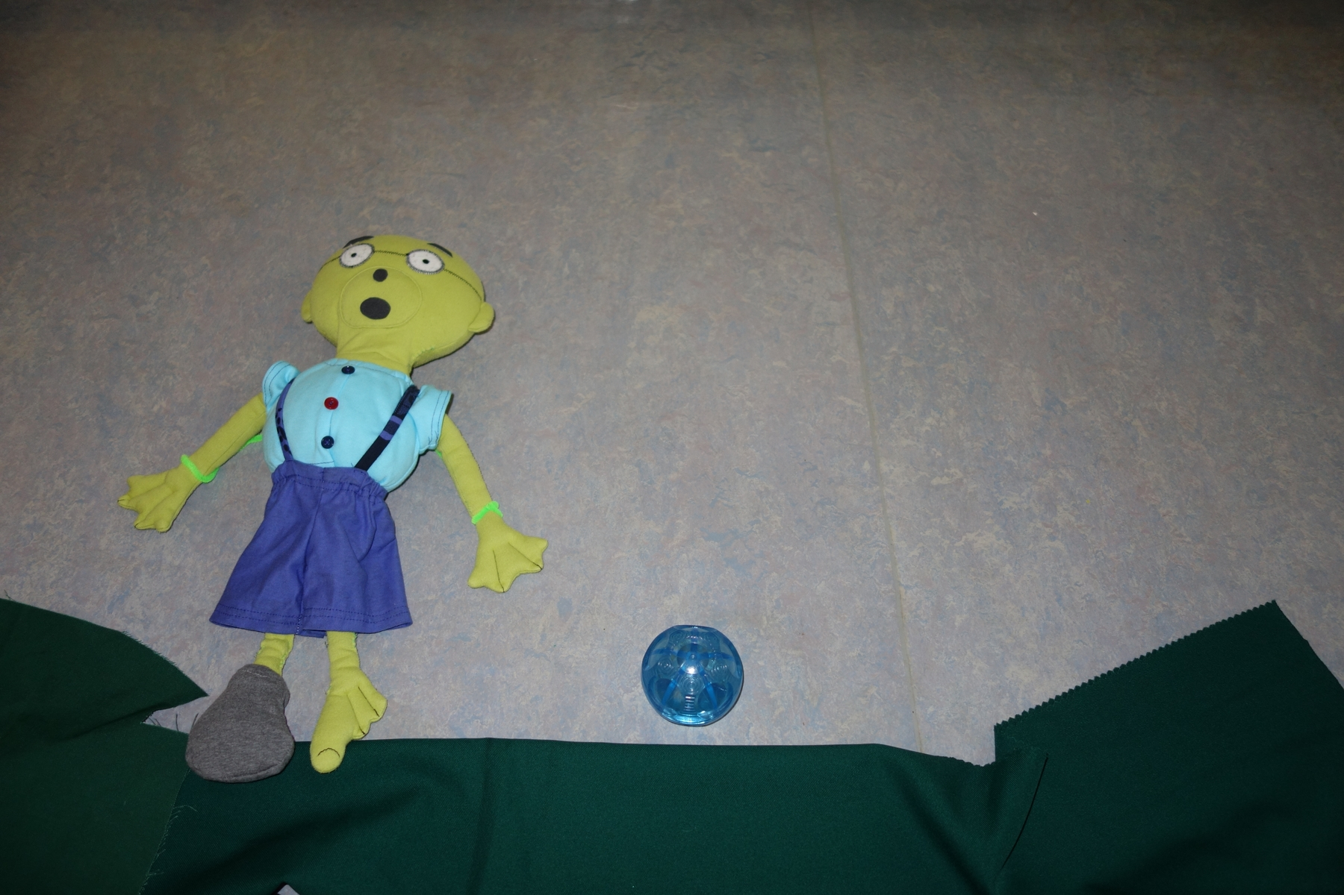
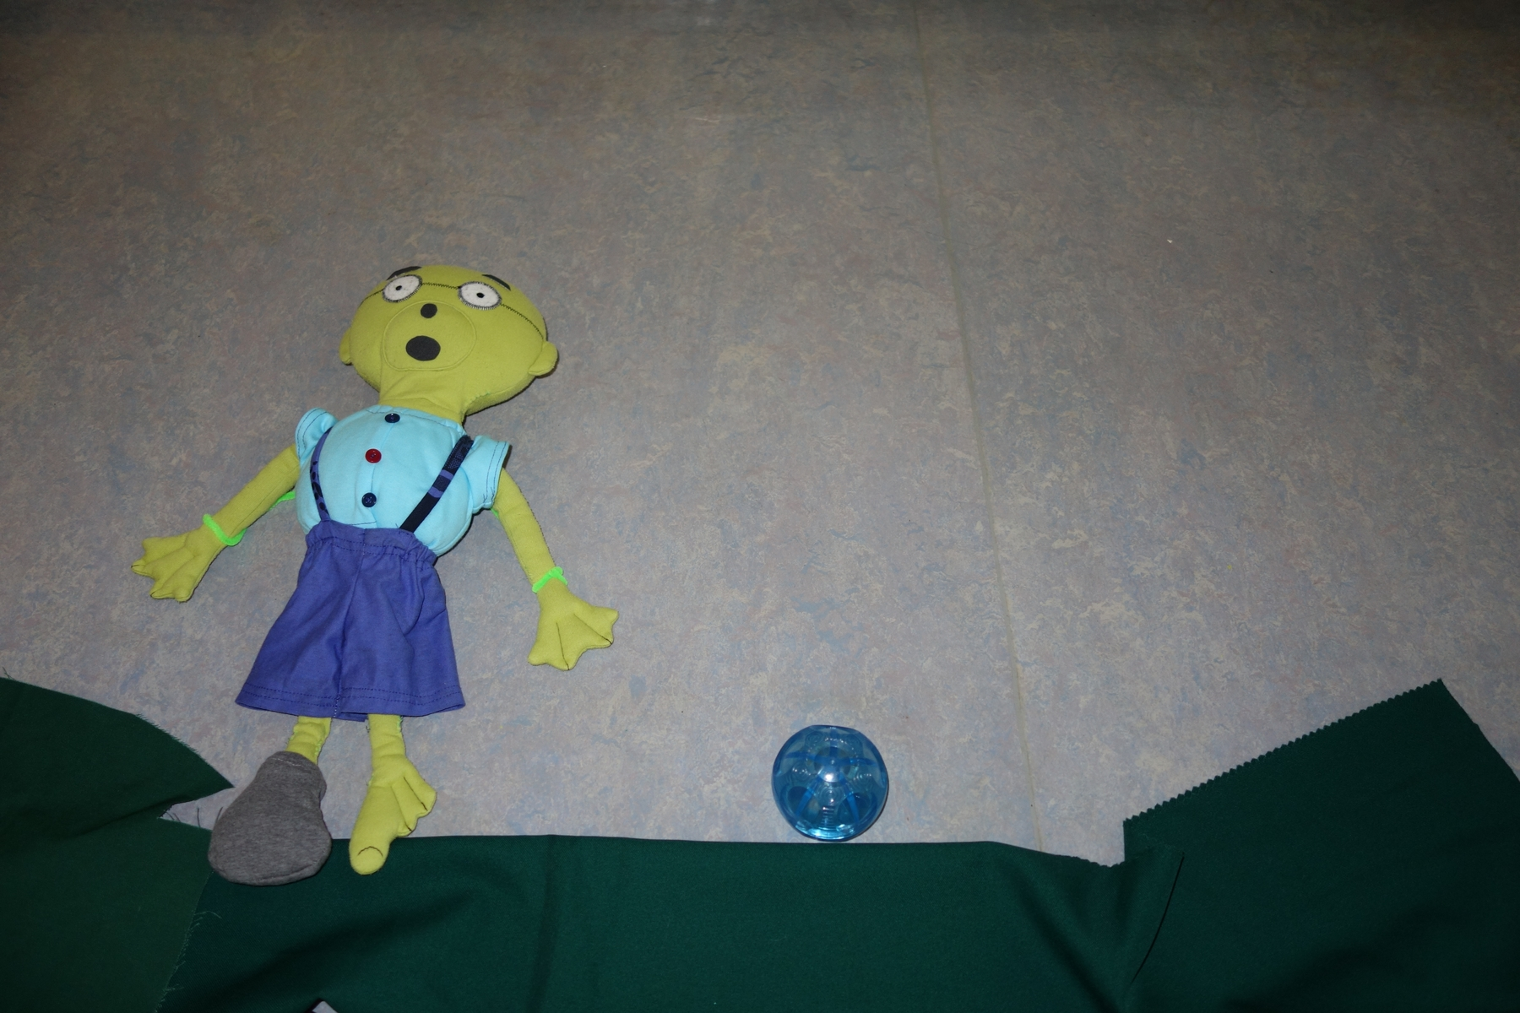
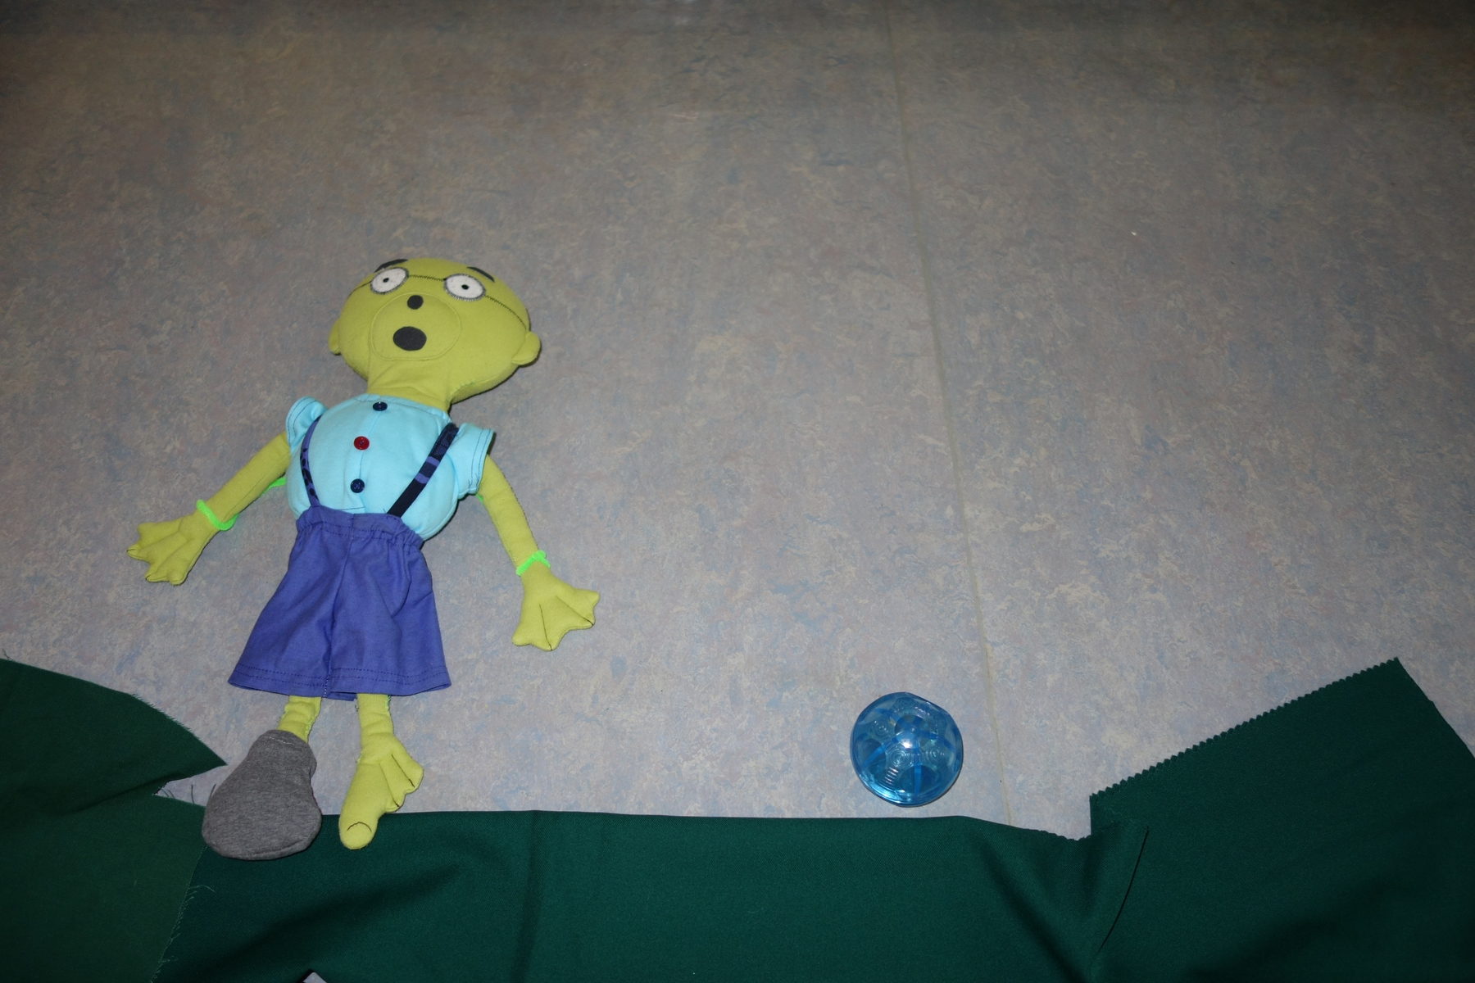
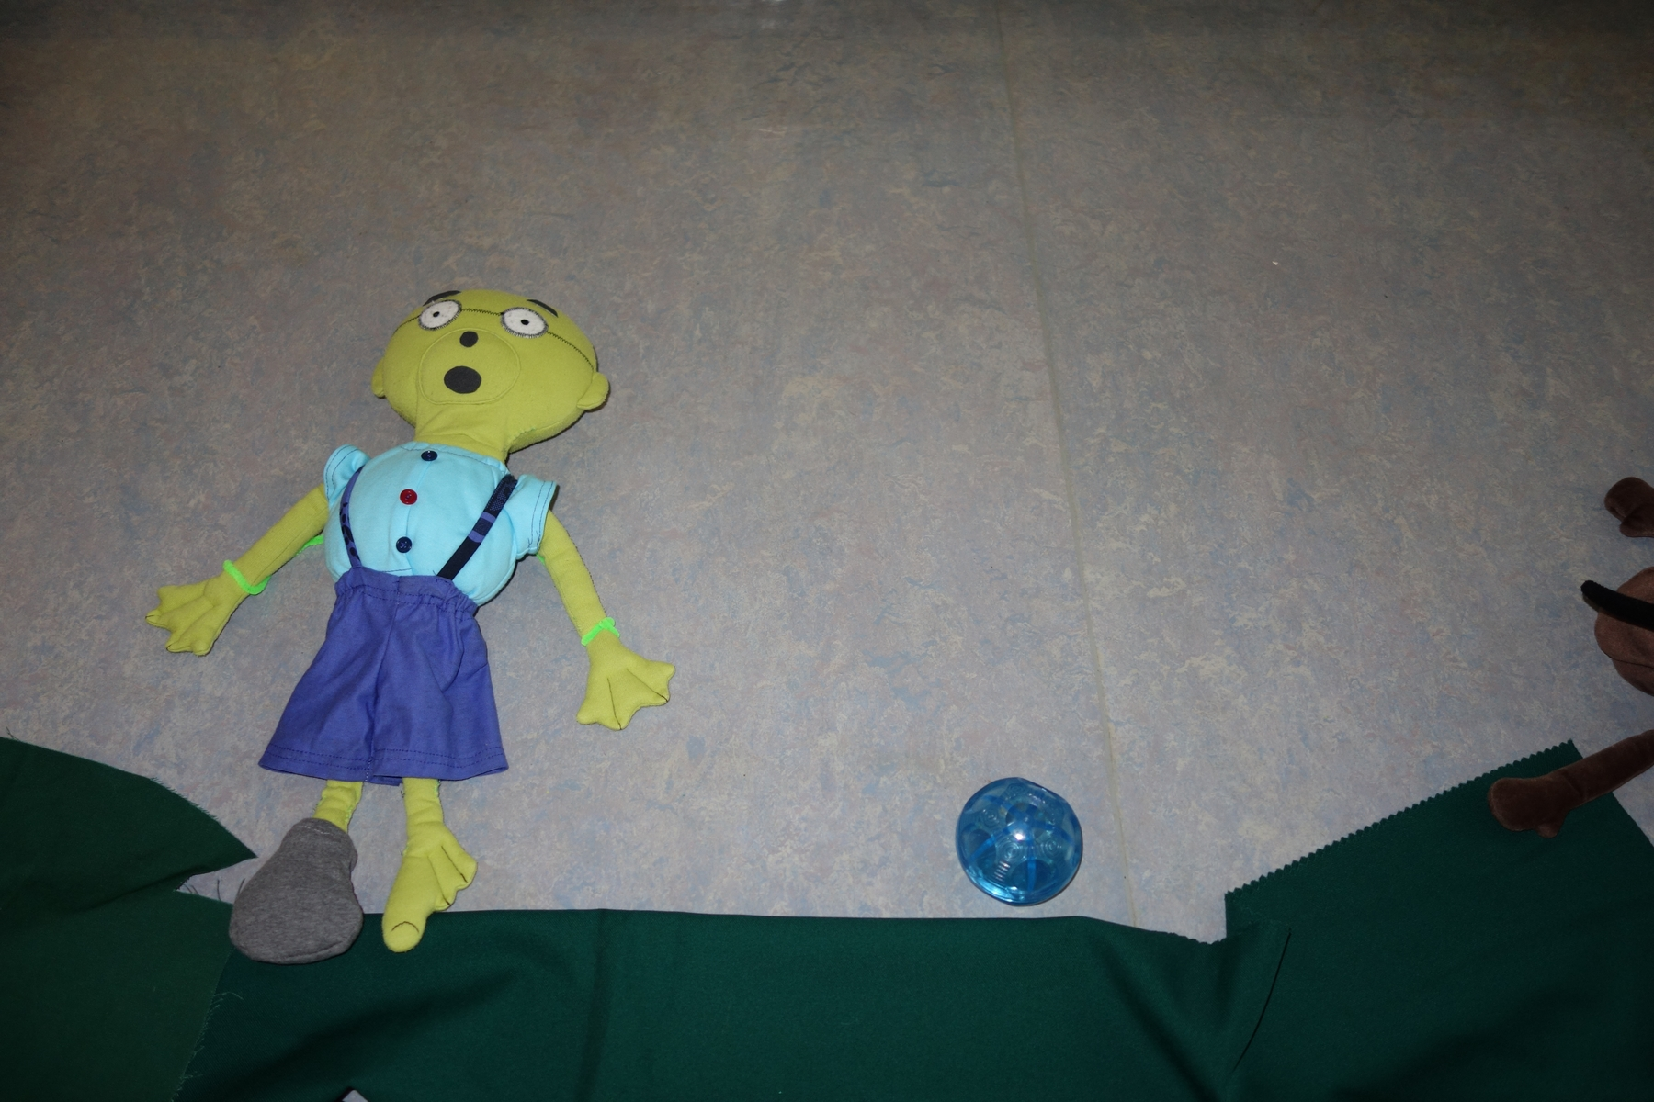
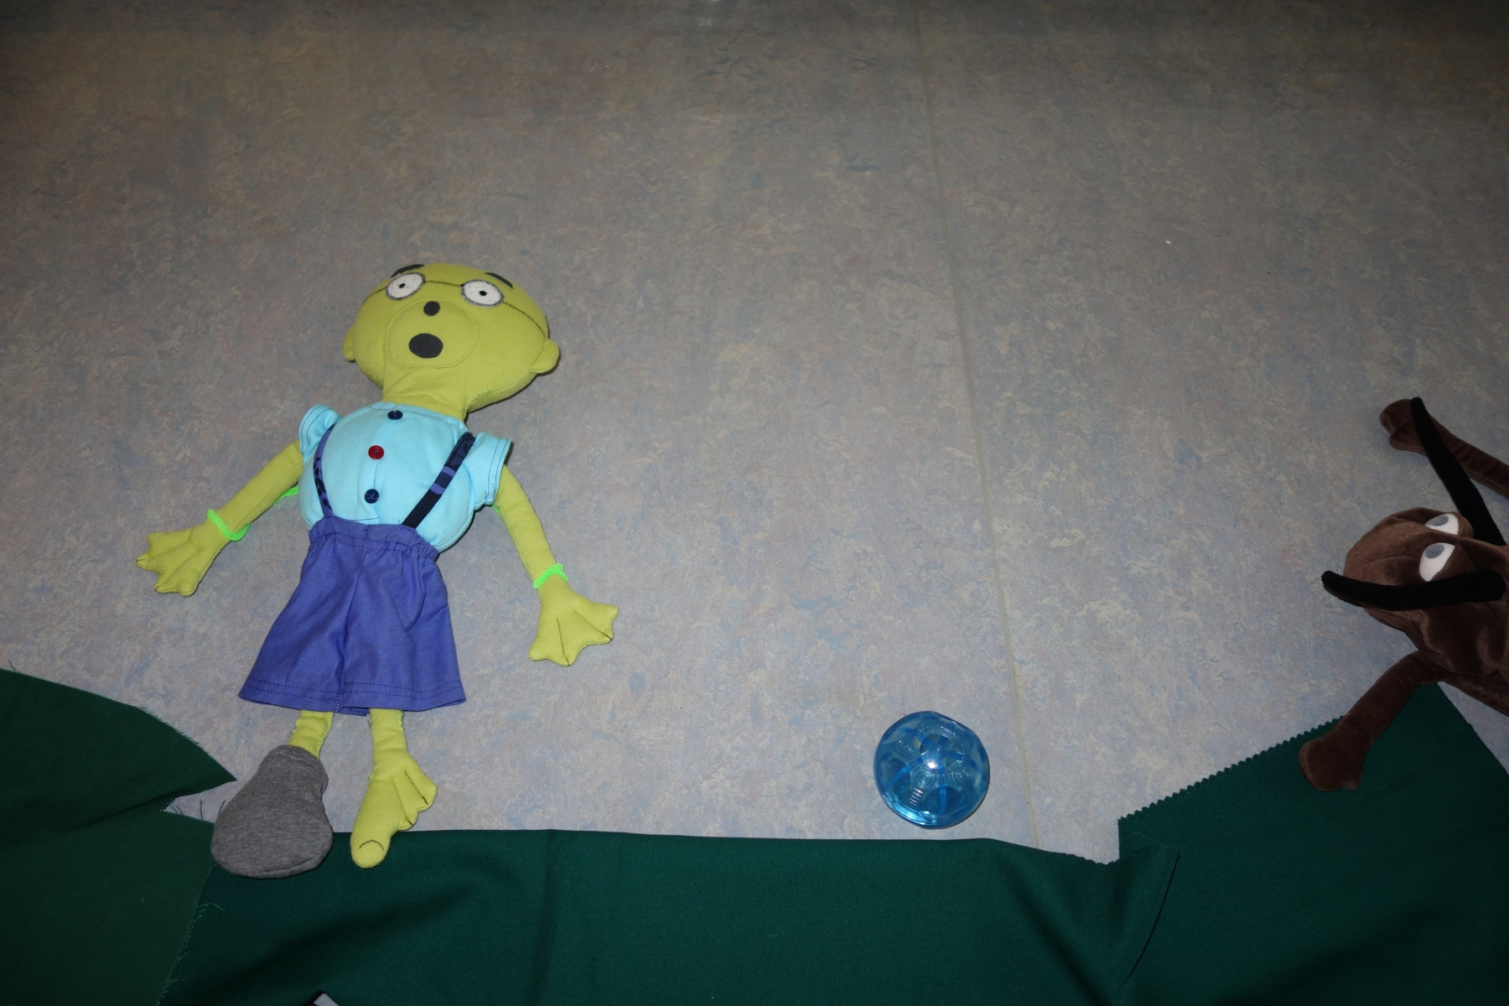
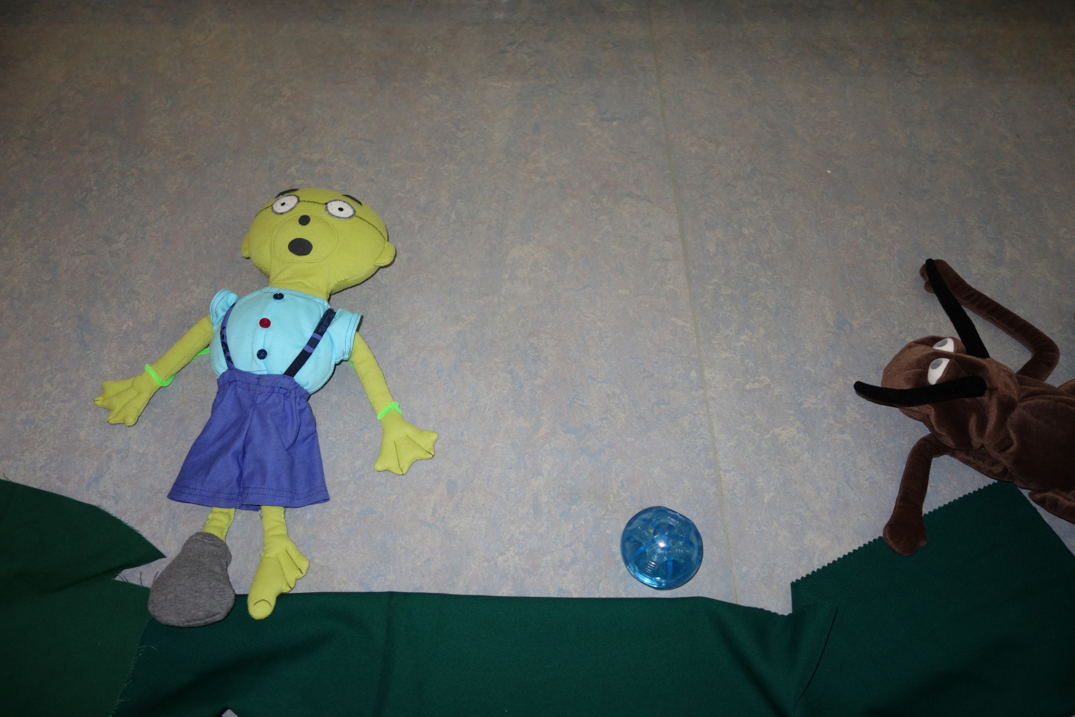
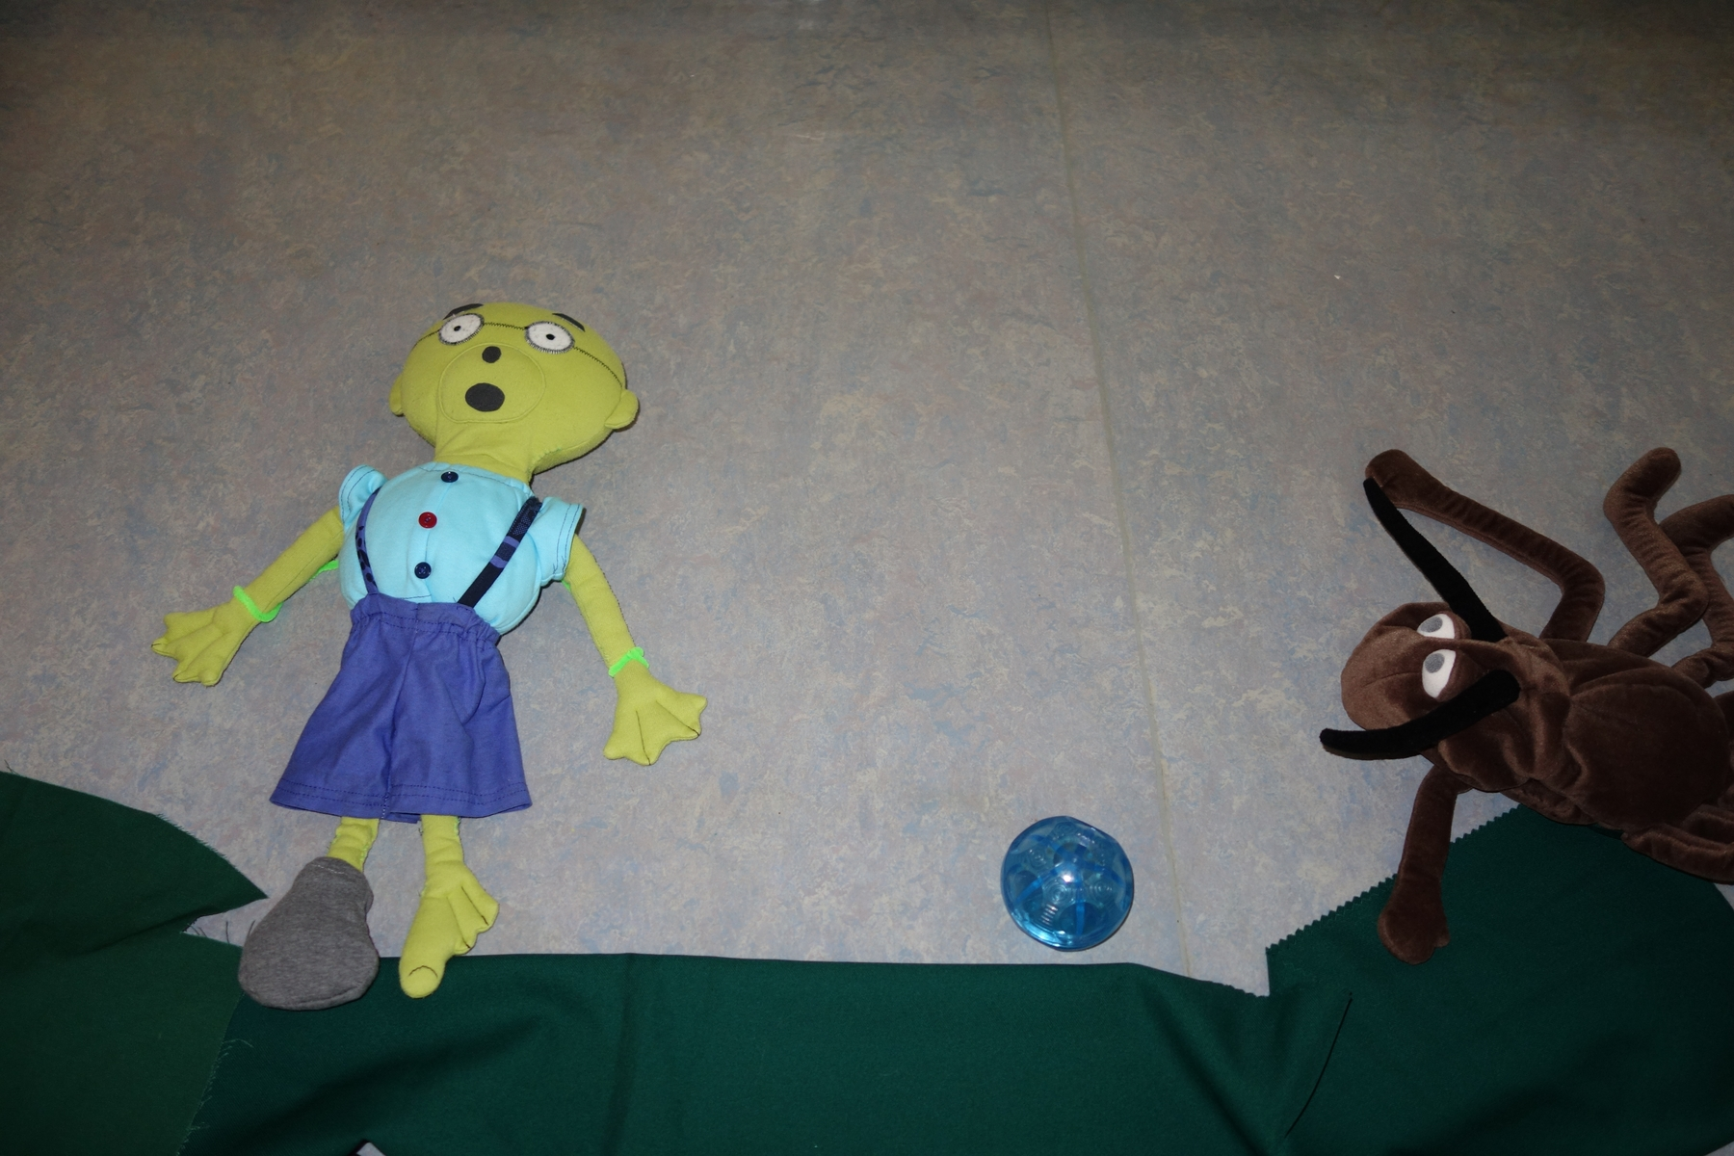

Slide 6
Every bit of movement was slight and accurate.

Slide 7
For creating titles we used play-dough and coloured pencils.

Slide 8
Most events in animation was improvised. The children were giving ideas what will happen with Medvodko.

Slide 9
At the end we took more than 700 photos. We used application „Dictaphone“ on a mobile phone to record the voices of the children.

